Slide 1

Alfa-Auto, Edition 5
Automobile business solution

Slide 2
Product information
“Alfa-Auto” – complex solution for automobile business companies. It provides maintenance of operational and management company accounting as well as management of main business processes.
“Alfa-Auto” is suitable not only for small auto-services and accessory shops but also for car dealerships and authorized dealers of car brands
The solution is developed on “1C:Enterprise 8” platform

Slide 3
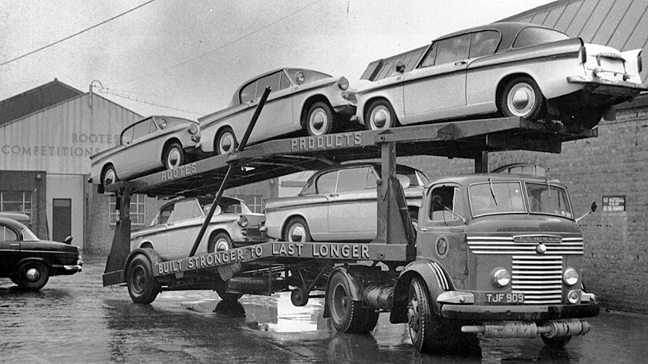
History of Alfa-Auto
1997
May 2000
June 2002
May 2005
February 2012
release of “Alfa-Auto” edition 2 on “1C:Enterprise 7.7”
release of “Alfa-Auto” edition 3 on “1C:Enterprise 7.7”
release of “Alfa-Auto” edition 4 on “1C:Enterprise 8”
release of “Alfa-Auto” edition 5 on “1C:Enterprise 8.2”
The history of the software product begins
over 250 copies were sold.
over 3500 copies were sold.
over 3500 copies were sold (more than 25000 licenses).
over 1000 copies were sold.

Slide 4
Dealers that use “Alfa-Auto”
Vehicle brand | Number of dealers
AVTOVAZ | 84
Hyundai | 86
Renault | 82
Chevrolet | 64
Toyota | 59
Kia | 69
Ford | 60
Opel | 56
Nissan | 44
Skoda | 38
Volkswagen | 47
Mitsubishi | 42
Honda | 33
Fiat | 33
Volvo Truck | 25
Vehicle brand | Number of dealers
Scania | 29
UAZ | 33
TAGAZ | 22
GAZ | 24
Mazda | 22
Ssang Yong | 25
Chery | 20
Peugeot | 20
MAN | 18
Mersedes | 24
Geely | 18
Citroen | 14
Hummer | 11
Suzuki | 13
KAMAZ | 15
Data as of 01.01.2014

Slide 5
Alfa-Auto user’s “portrait”
Alfa-Auto clients are automobile business companies with various number of users.
Data as of 01.01.2013

Slide 6

Alfa-Auto geography
Alfa-Auto solutions sales geography:
Ukraine (localized version)
Belarus
Moldova
Kazakhstan
Turkmenistan
Kyrgyzstan
Azerbaijan
Latvia
Estonia
Russian Federation

Slide 7

Main purposes of implementing “Alfa-Auto”
Optimization of company’s main business processes
Reduction of customer service time through the use of efficient program processes
Providing quick access to any information
Providing objective information of company’s operations
Protection of commercial information, distinction of users depending on information access level
Development of system together with business evolution

Slide 8
Competitive advantages
Accounting of activities of all company’s departments in a single information space (automobile sales, auto-service, spare parts, finance, marketing)
Design and creation of system specifically for automobile business enterprises
Efficient and reliable workflow of auto-service, spare parts and automobiles sales
Well thought out mechanism of program's subsystems interaction
Integration with external information systems: spare parts and color matching catalogues.
System is based on the familiar to users platform “1C:Enterprise 8”, that provides efficient operation and reliable data storage
Steady operation of the system with any number of users
Further developments can be carried out as by efforts of involved programmers, as by owner’s own forces

Slide 9




Implemented business processes
Following business processes are implemented in “Alfa-Auto”
Sales of spare parts wholesale
Sales of spare parts in retail
Repair of automobiles
Automobile sales

Slide 10
Business processes
Sales of spare parts wholesale
Sales of spare parts from company’s warehouses
Advance reservation of spare parts for customers
Spare parts orders for customers
Adjustment of customer’s orders, replacement of spare parts against orders, removal of spare parts reservation
Spare parts order to suppliers
Receipt of spare parts to company’s warehouses
Spare parts sales with execution of required set of documents (Invoice, TORG-12, Factura invoice)

Slide 11
Workflow diagram
Sales of spare parts wholesale
Customer’s order
Adjustment of
Customer’s order
Is product in stock?
Yes
No
Adjustment of
Order to supplier
Order to supplier
Reservation of
spare parts
Removal of
reservation
Shipment of
spare parts
Invoice
Receipt of spare
parts to warehouse
Factura invoice
Payment by
cashier or bank

Slide 12
Business processes
Sales of spare parts in retail
Sales of spare parts in retail using fiscal data recorder and specialized cashier workspace
Execution of sales Сash receipt and summery reports of cash register ( X-report, Z-report)
Ability to accept cash and non-cash payment
Ability to register returns of a customer on the day of purchase or any other day
Performing of encashment
Closing shift at the end of the day

Slide 13
Workflow diagram
Sales of spare parts in retail
Сash receipt
Сash receipt
Сash receipt
Сash receipt
Returns by cash
receipt
Closing shift
Z-report
Returns next day
Encashment

Slide 14
Business processes
Сar repairs/Workshop
Resource planning in the workshop
Calculation of preliminary cost of repair
Reception of car for repair
Phased repair (request, in progress, repair completed, Work Order closed) and monitoring of repair
Spare parts movement from warehouse to workshop under Work Order and return of unused parts back to warehouse
Monitoring the need to perform any service campaign
Drawing up an act of disagreement for adjustment of revenue under Work Order
Executing full package of documents under Work Order (Invoice, Receipt for Work Order, TORG-12, Factura invoice and others)

Slide 15
Workflow diagram
Repair of automobiles
Calculation of repair
Register for repair
Reception of car
for repair
Act of disagreement
Spare parts order
for customer
Work Order
Factura invoice
Spare parts
order to supplier
Transfer of spare
parts for repair
Invoice
Transfer of spare
parts for repair
Receipt of spare
parts to warehouse
Return of spare parts
from repair
Payment by cashier
or bank

Slide 16
Business processes
Automobile sales
Registration of customer’s and warehouse orders for automobiles
Automobile reservation for customer
Advance payment for automobile under customer’s order
Automobile order to supplier
Automobile purchase in personal property or safe custody
Purchase of new or used automobiles
Pre-sale preparation of automobiles (resupply)
Automobile sales to customer, executing set of documents (Invoice, TORG-12, Factura invoice)

Slide 17
Workflow diagram
Car sales
Customer order
at the car
Purchase car order
PDI (pre delivery
inspection)
Prepayment
under order
Receipt of car
Car sales
to customer
Factura invoice
Invoice
Payment by
cashier or bank

Slide 18
Alfa-Auto subsystems
Functional modules of “Alfa-Auto”:
  Spare parts
  Workshop
  Car sales
  Mutual settlements
  Movement of funds
  Income & expenses
  Budgeting
  Customer relationship
  Other assets
  Managing and service
Common database
Mutual settlements & movement of funds
Income & expenses
Customer relationship
Budgeting
Spare parts
Other assets
Managing and service
Car sales
Workshop

Slide 19
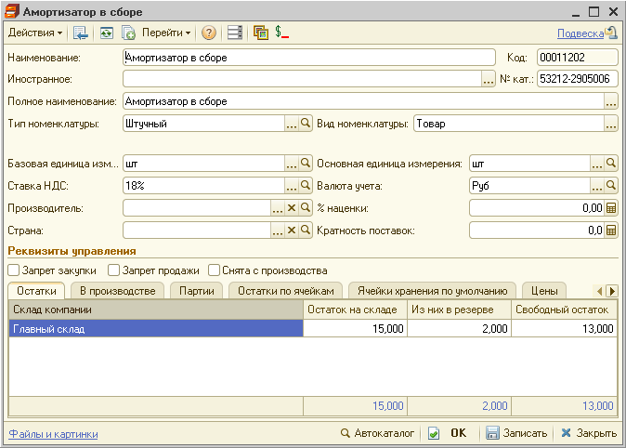
Spare part’s card
Form of card and nomenclature list contains information and accounting data of spare parts:
  Quantity on stock
  Work in progress
  Prices
  Prices of partners and
  competitors
  Replacements and equivalents
  Applicability by car model
  Frequency of supplies
  Ban to buy or sell
  Minimal remainder
  Unfilled customers orders and
  orders to suppliers

Slide 20
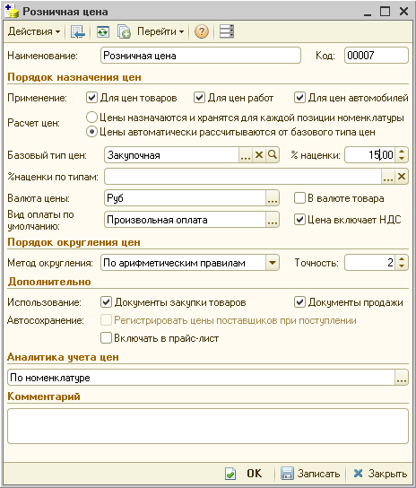
Pricing by spare parts
Different ways to form spare parts prices:
  Price setting for each parts item by documents
  Automatic mark-up pricing according to basic price type
Parameters of price types:
  Application area (spare parts, auto-works, automobiles)
  Currency of price
  Usage (purchase documents, sales documents)
  Analytics of price’s accounting and formation (by spare parts,
  characteristics, unit of measurement)

Slide 21
Discounts at spare parts
The program uses a flexible system of discounts:
  Discount on entire customer’s order
  Discount on certain items in sales document
Terms of discounts can be assigned:
  List of spare parts and auto-works that are covered by discounts
  Customer’s current sell price
  Discount card and amount of savings on it
  Days of the weeks and time of discounts
  Discount to contractor
The ability to grant discounts to
customers is regulated at the level of
user rights

Slide 22
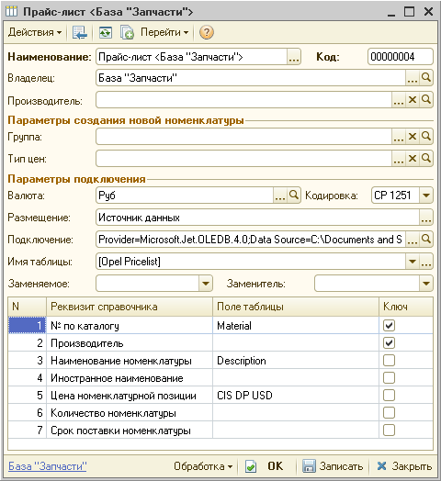
Price lists of the suppliers
External price lists can be connected for storing in database of suppliers’ price lists
Supported formats of price lists: xls, ods, txt, mdb
Following price list options are
included:
  Spare parts search in price lists by
  catalogue number
  Creation of spare parts card and
  prices out of price list
  Load he replacement spare parts
  Updating of price lists and its prices

Slide 23
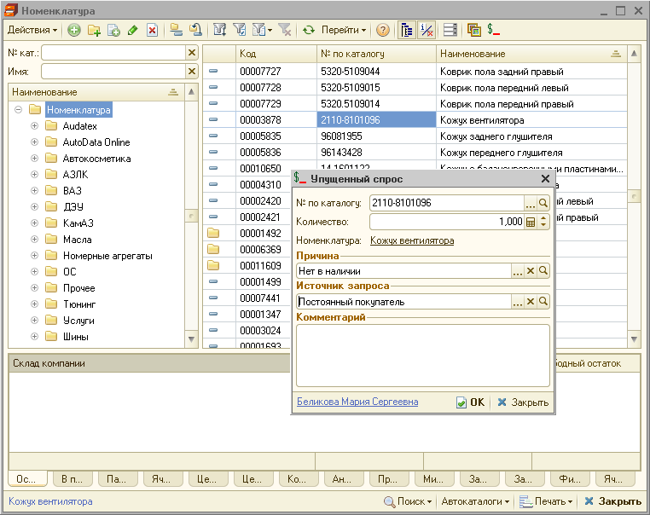
Lost demand
Registration of spare parts lost demand from nomenclature catalogue and sales documents
Requested quantity
Reason of loss
Source of request

Slide 24
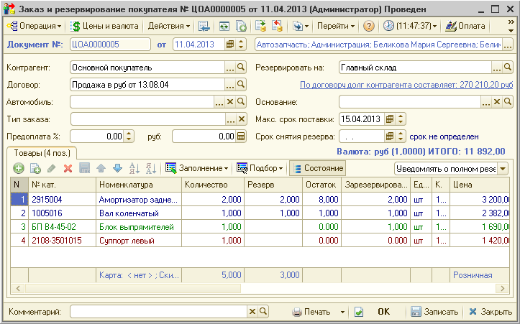
Customer’s order
Customer’s order allows to issue commercial offer, to reserve available spare parts and order missing spare parts.
Notifications to managers
Requested quantity
Reserve from stock
Status of reservations

Slide 25
Purchase order
“Alfa-Auto” has mechanisms of calculating requirements of spare parts in warehouses. So purchase order can be created:
  According to customers’ and subdivisions’ orders
  According to minimum balances
  According to sales of selected supplier
  According to calculations based on sales statistics (taking into account equivalents):
    Monthly sales for a year
    Amount of sales documents
    Amount of work in progress
    Sales forecast for a set period
Notes:
Вставить скриншот Заказ поставщику

Slide 26
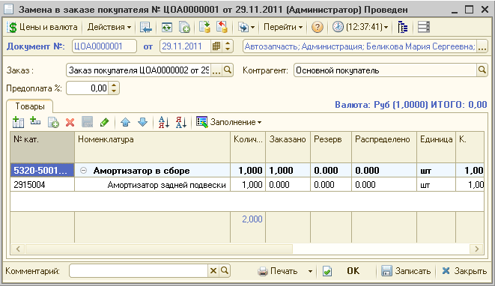
Adjustment orders
The program supports different adjustments of customer’s orders and orders to suppliers:
  Adjustment of spare parts’ list in orders
  Replacement of parts
  Removing of reservations on spare parts

Slide 27
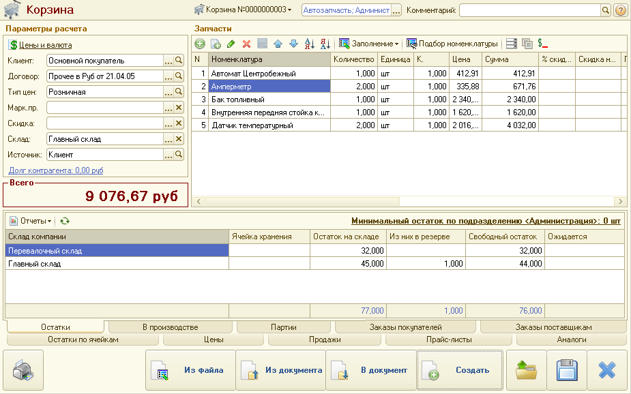
Cart\basket
Automated workplace of seller simplifies selection of spare parts and drawing up documents:
  Information output about balances, orders and sales of selected spare parts
  Saving selected spare parts to cart
  The opportunity to return to a previously saved cart and create necessary documents: customer’s order, realization of goods and others.

Slide 28
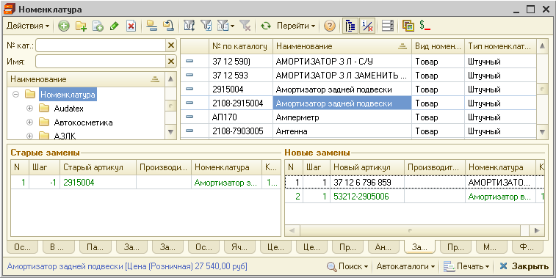
Replacement spare parts
List of replacements can be stored for each spare part
In spare parts selection replacements are taken into account

Slide 29
Receipt of goods to warehouse
Warehouse receipt can be filled:
Based on purchase order
Based on e-file
Based on spare parts barcodes, read by barcode scanner or data acquisition terminal
Upon receipt of spare parts under purchase order, reservation of spare parts under customers orders is made automatically

Slide 30
Sales of spare parts
Sales of spare parts to customer can be carried out wholesale or in retail:
  Wholesale
    Document “Realization of goods”
    Sales can be carried out with or without pre-order (reservation) of goods
    Executing full package of documents (Invoice, TORG-12, Factura invoice)
  Sales in retail
    Document “Сash receipt”
    Impersonal sales with the use of trade equipment (cash register).
Notes:
???

Slide 31
Warehouse documents
“Alfa-Auto” contains a set of all necessary warehouse documents:
Goods movement
Write-off of goods
Inventory
Re-grading
Assembly of kit
Disassembly of kit
Picking
Transfer of spare parts in the workshop

Slide 32
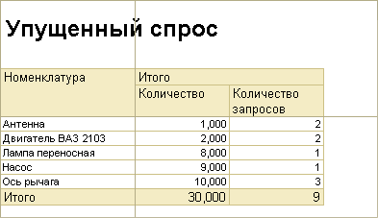
Warehouse and sales reports
Analytical reports:
  Analysis of sales and trade margin
  Analysis of price changes
  Analysis of lost demand
Reports on orders:
  Status of customers orders
  Status of orders to suppliers
  Overdue reserves
Warehouse reports:
  Balances and sales of consignments
  Movement of goods
  «Work in progress» report
  Deadstock spare parts

Slide 33
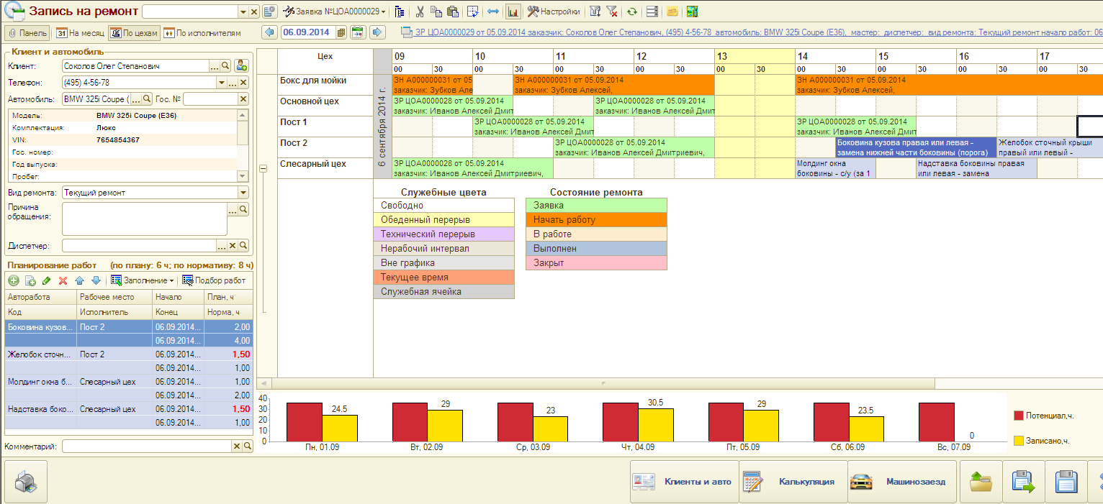
Planning the visit of customer
“Alfa-Auto” has a convenient tool for planning visit customer to the workshop. The tool allows you to schedule time of of mechanics and workplace (lifts).

Slide 34
Labor time and pricing
Labor catalogue stores information about time allowance in terms of car models and their grade.
Pricing on labor (cost of labor hour) can be set on following parameters:
Labor (group of labors) – mandatory term
Organization
Type of repair
Workshop
Car model
Customer and contract of settlement payments

Slide 35
Pre-calculation
“Alfa-Auto” has a tool for calculating estimated cost of repair – document “Request for repair”.
Calculation can be saved in database for later analysis.
Work Order can be created based on calculation.
Calculation (Request for repair) can be linked to customer’s car order
Calculation can be used in case of executing installation of additional equipment.

Slide 36
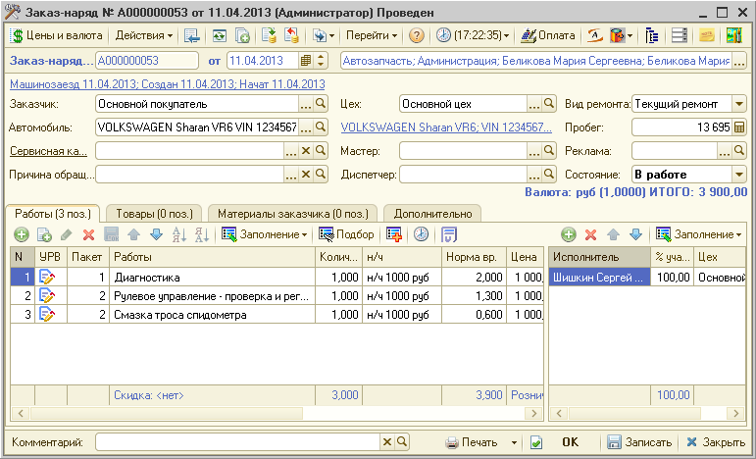
Work Order
Main document of auto-service – “Work Order”.
Place of repair
Mileage at the time of executing Work Order
Information about customer and car
List of labors and spare parts
Total cost of repair

Slide 37
Work Order
Review of customer and automobile history
Ability to reserve spare parts during selection
Missing parts order
Appointment for spare parts issue from warehouse
Review or detail’s recipients
Selection of related works (work + spare part)
Data upload from programs that calculate labor intensity (Silver-Dat II, Autodata, Autodata Online, Audatex, Автонормы, AutoSoft)
Automatic distribution of working-out to mechanics depending on the amount of work performed and the percentage of participation
Work status display (not started, in progress, suspended, completed)

Slide 38
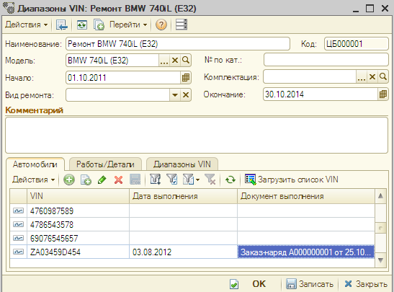
Service campaign
Tracking the need to run service campaign at the stage of Work Order execution
List of VIN numbers in service campaigns can be loaded from a file (xls, ods, txt, mdb).
Service campaign can be executed in current or new Work Order (new request for repair).
Car model and campaign period
Range of VIN numbers
Date and document of campaign execution

Slide 39
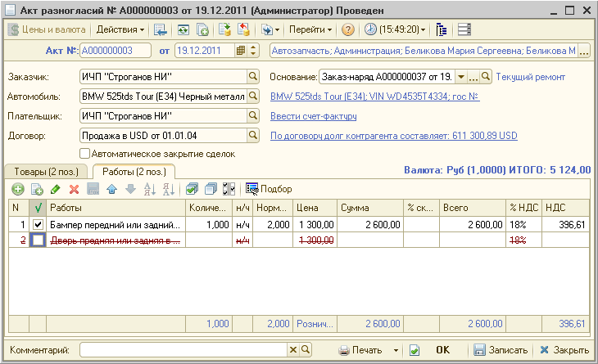
Act of disagreement
Act of disagreement corrects revenues and settlement payments of closed Work Orders (e.g. insurance or warranty repair)

Slide 40
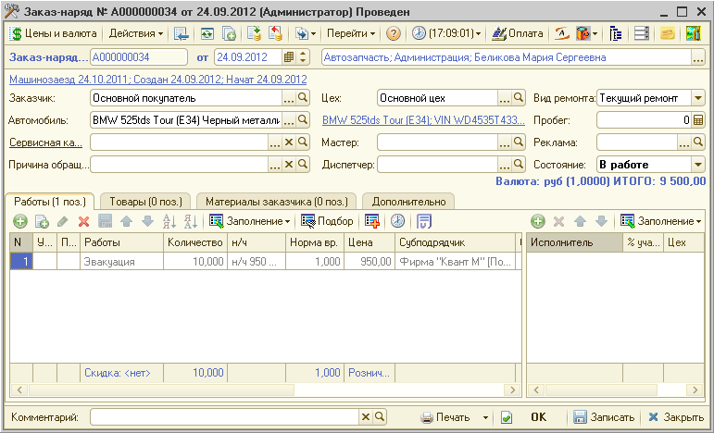
Subcontracted work
Subcontracted works can be considered during car repairs
Subcontractor
Subcontracted work

Slide 41
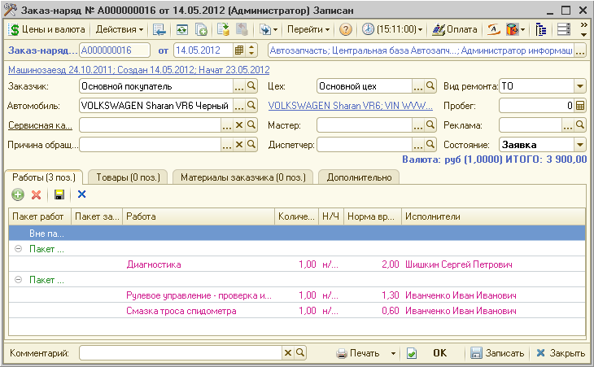
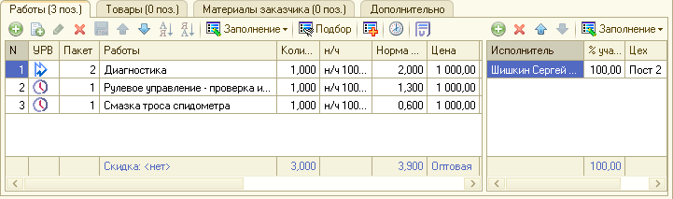
Work time logging
"Alfa-Auto" allows to collect data on actual time spent to perform work on repair.
Editing of work packages in Work Order
Status of work execution

Slide 42
Workplace in auto-service
Automated workplace (AWP) of auto-service is designed to make service staff members’ work more quick and convenient.
AWP consists of 6 functional panels:
Customers and automobiles
Calculation
Appointment for repair
Automobile arrival
Work Orders
Reports

Slide 43
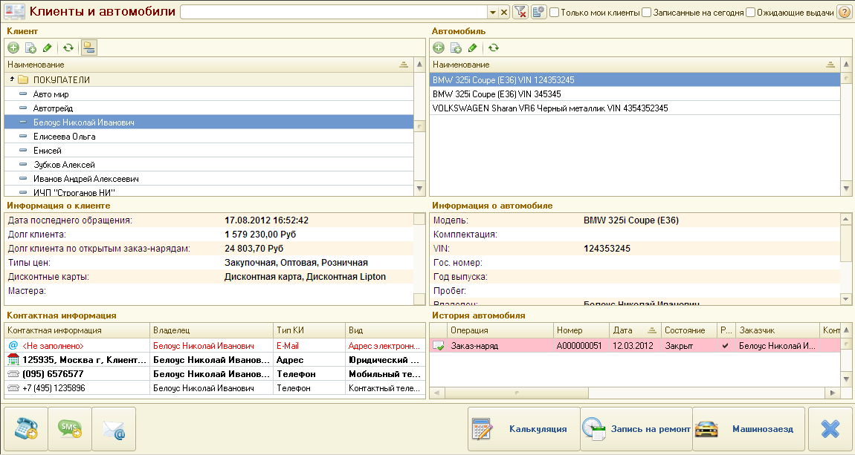
  Workplace in auto-service
  Functional panel: Customers and car
Customers selection, (appointed for today / waiting for car issue)
List of car of selected customer
List of customers
Information about customer’s last application and debt
Customer’s contact information
Repair history of selected car

Slide 44
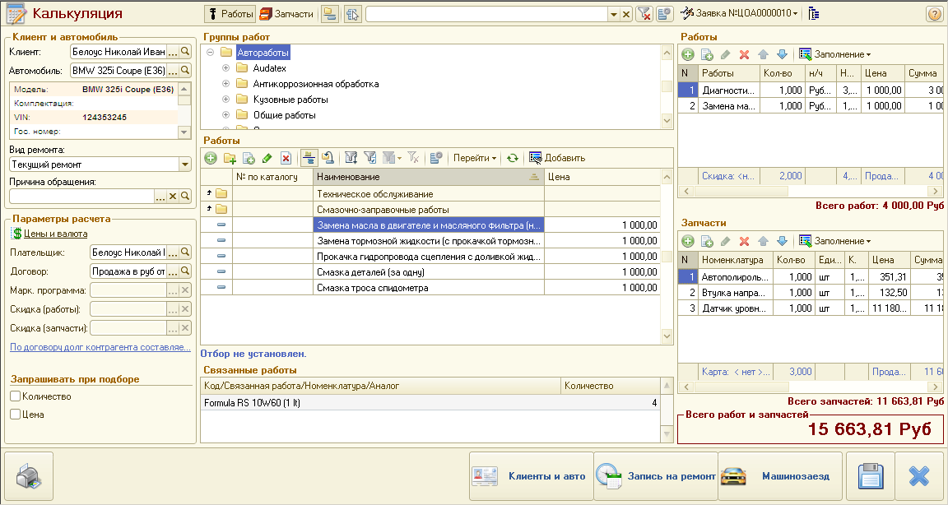
Workplace in auto-service
Functional panel: Calculation
Selection of spare parts and labors for pre-calculation
Customer, car, reason for repair
Selected spare parts and labors
Payment parameters (customer’s contract, discounts, prices)
Total calculated cost of repair

Slide 45
Workplace in auto-service
Functional panel: Appointment for repair
Planning considering workshops and performers
Planning calendar
Works that must be planned
Detailed explanation of calendar colors
Works, planned on workshops

Slide 46
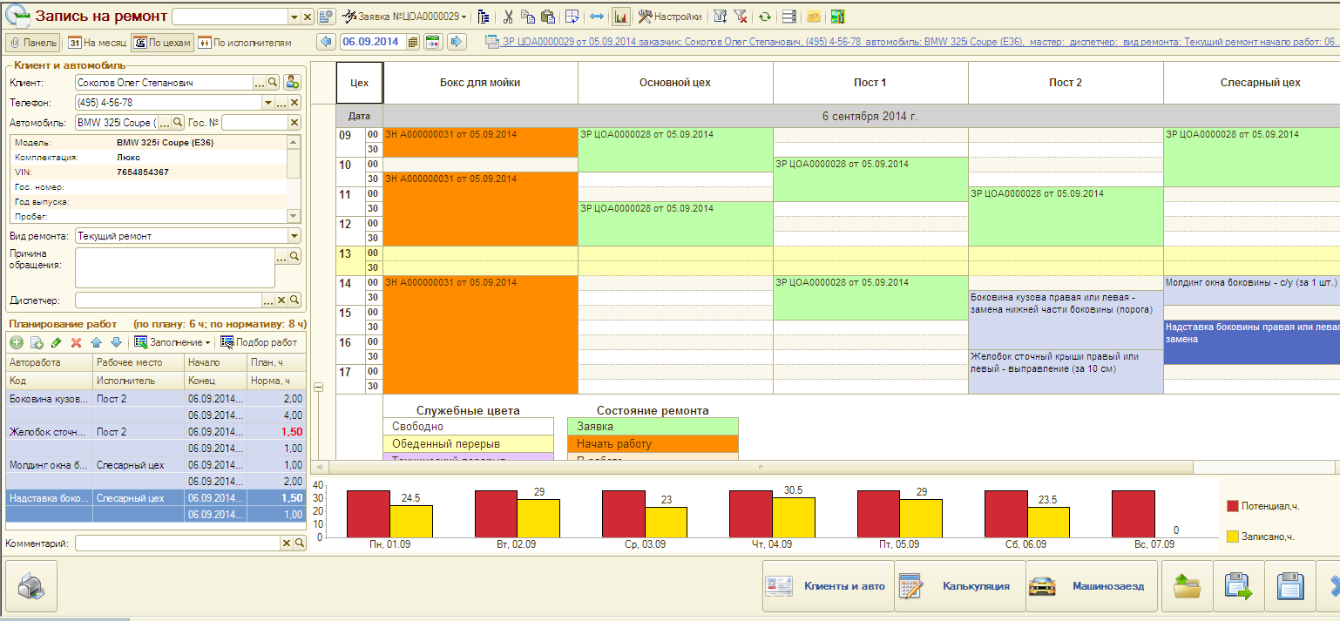
Workplace in auto-service
Functional panel: Appointment for repair
Vertical alignment

Slide 47
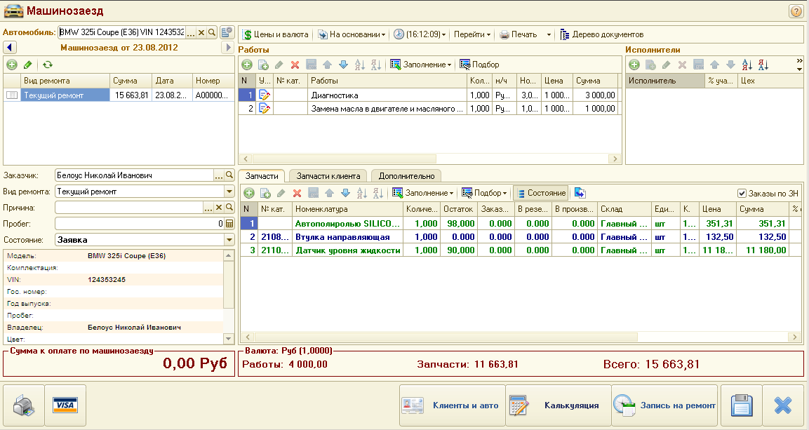
Workplace in auto-service
Functional panel: Automobile arrival
List of calculated labors and spare parts
Type of repair (as in Work Order)
Status of Work Order

Slide 48
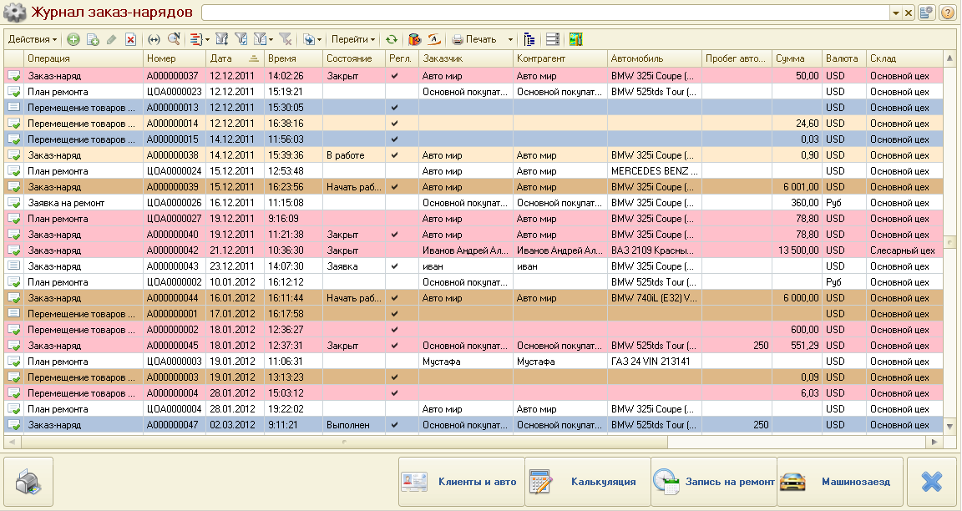
Workplace in auto-service
Functional panel: Work Order journal
Search by customer, VIN, license plate number
List of Work Orders and Calculations

Slide 49
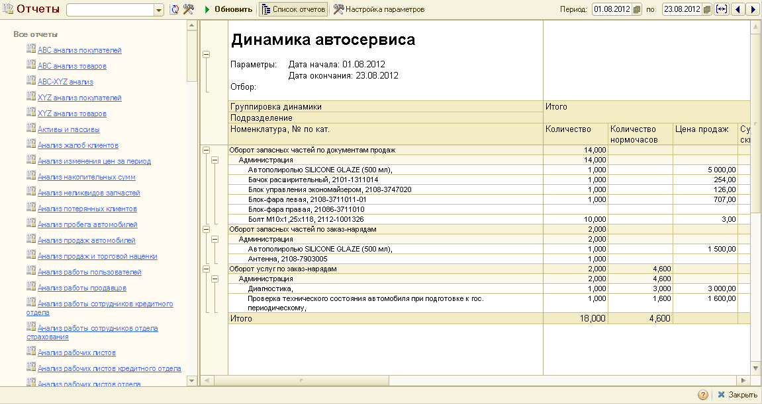
Workplace in auto-service
Functional panel: Reports
List of reports
Formed report

Slide 50
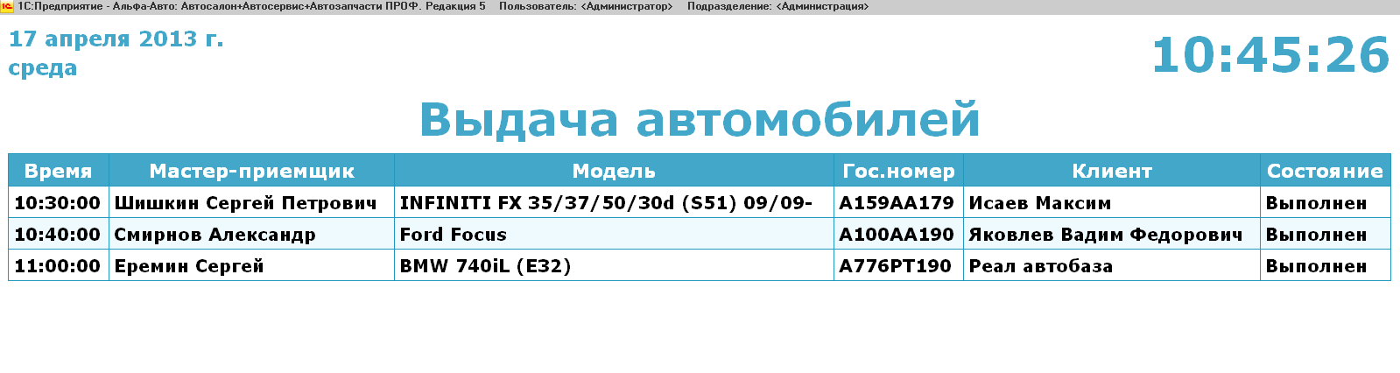
Auto-service monitor
Customers can track readiness of automobiles using auto-service monitor.

Slide 51
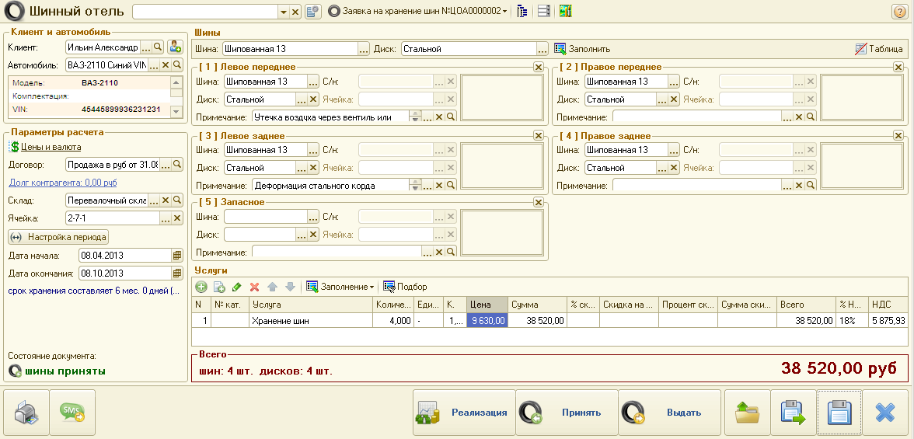
Storage tires
Reception of tires for storage is implemented with the help of workplace “Tire hotel”
Tires, their images, notes about defects, etc.
Storage data of tires
Expiry date of tires

Slide 52
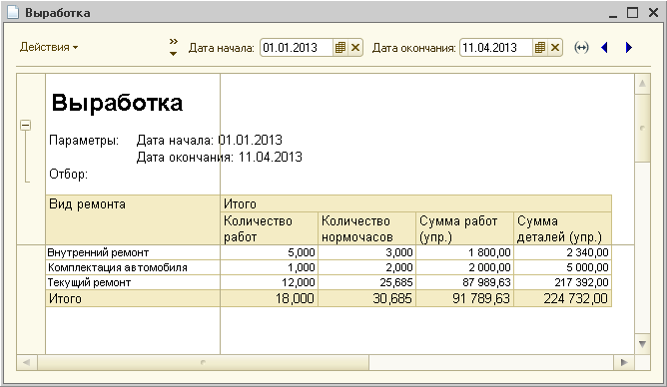
Workshop reports
Sold and elapsed time
Summary sheet
History on repair
Dynamics of auto-service
Execution of service campaigns
Analysis of lost customers
Report on subcontracted works
Hours worked mechanics

Slide 53
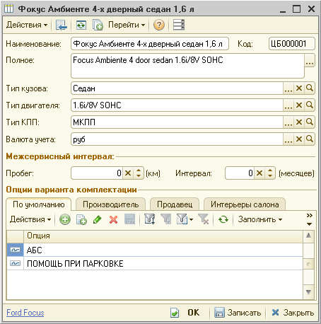
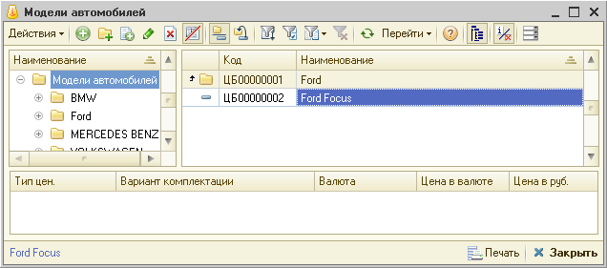
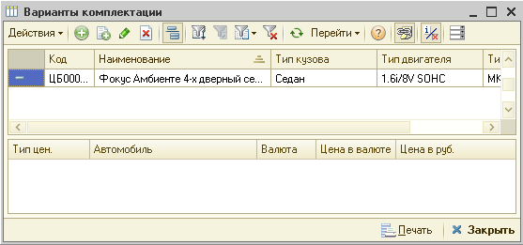
Car models and grades
Car structure:
Make of vehicle
Model
Equipment level
Options

Slide 54
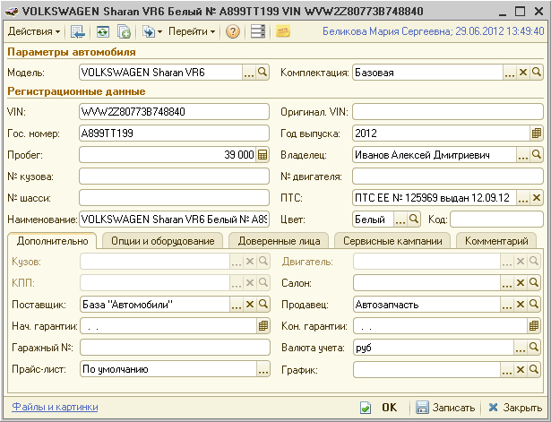
Car characteristics
Car properties:
  Model
  Grade
  VIN
  Original VIN
  Body number
  Chassis number
  Engine number
  Motor vehicle certificate of title
  Color
  License plate number
  Mileage
  Owner
  Options and set equipment

Slide 55
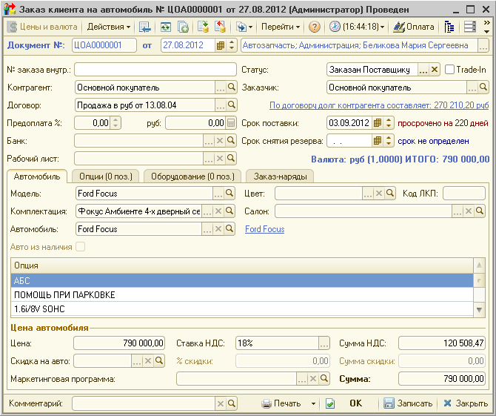
Customer’s car order
Orders are classified:
  Orders for customer
  Orders under Trade-In
Existing order can be canceled or re-issued for another customer

Slide 56
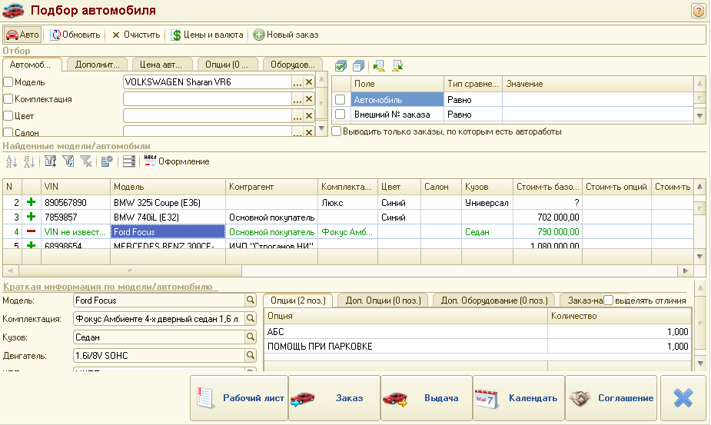
Customer’s car order
Car selection in orders takes into account car available in stock and car that were ordered but haven’t arrived yet.
Car search by model, grade, showroom
Car list after selection

Slide 57
Operations with the car
Customer’s car order
Purchase car order to supplier
Reservations, removal of reservations on car
Test drive
Arrival of car to warehouse
Arrival for safekeeping with subsequent passing into the ownership
Kitting and De-kitting of car
Car sales
Warehouse operation (stock movements, inventory, write-off car)

Slide 58
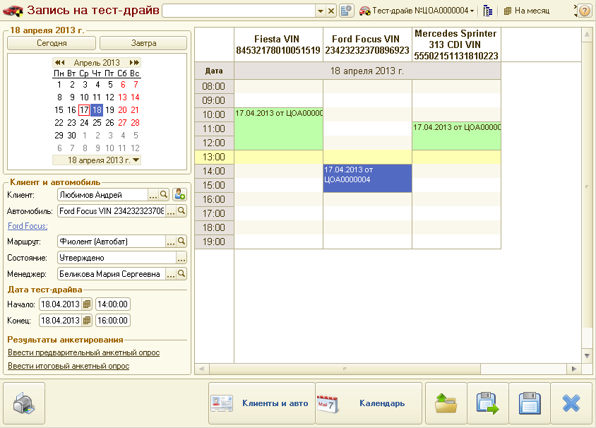
Test drive
Appointments for test drives
Calendar of planned test drives
Customer, car for test drive, route

Slide 59
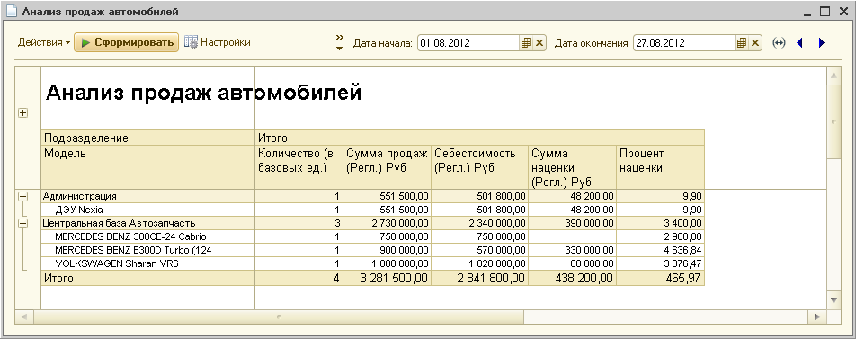
Car showroom reports
Balances and sales of car
Status of orders
Status of ordered car
Report on installed specialty-equipment
Analysis of car sales

Slide 60
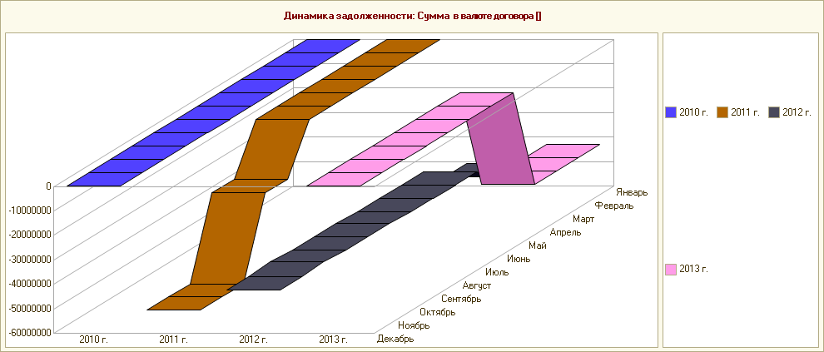
Mutual settlements
Set of documents:
  Advance report
  Set-off
  Correcting debt
  Deed of Payment Reconciliation
Reports
  Mutual settlements with contractors
  Repayment of debt
  Dynamic of debts
  Age of debts

Slide 61
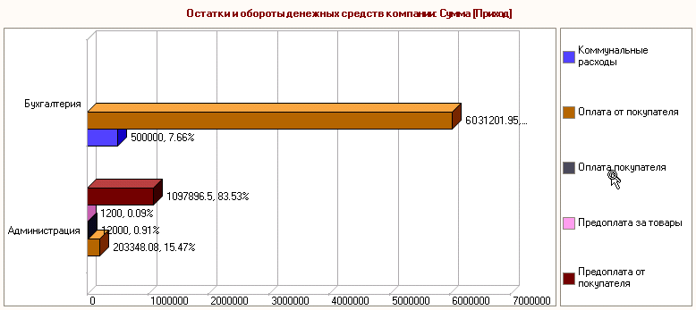
Movement of funds
Set of documents
Cash receipt and issue notes
Bank statement and transfer order
Encashment
Delivery-Acceptance Act of security papers
Reports
Balances and turnovers of capital
Bank customer

Slide 62
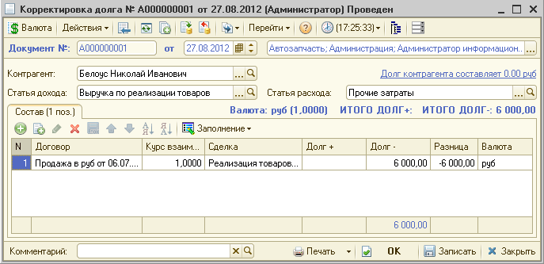
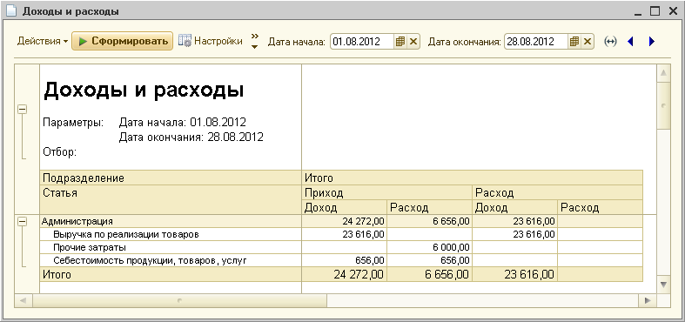
Income and expenses
Income or expense can be fixed by any document that tilts enterprise balance
Reports
Income and expenses

Slide 63
Budgeting
Budgets
Budget of spare parts sales
Budget of spare parts purchase
Budget of workshop
Budget of car sales
Budget of car purchase
Budget of funds movement
Budget of income and expenses

Slide 64
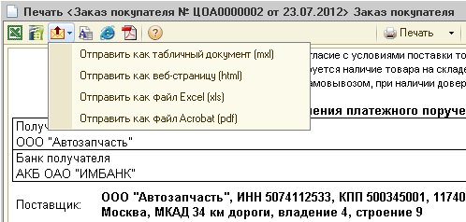
Customer relationship
Event – document for registration of contacts with customers: meetings, calls, letters and etc.
Email – reports and printing forms can be sent by e-mails
SMS – messages can be sent under documents (using www.sms4b.ru)

Slide 65
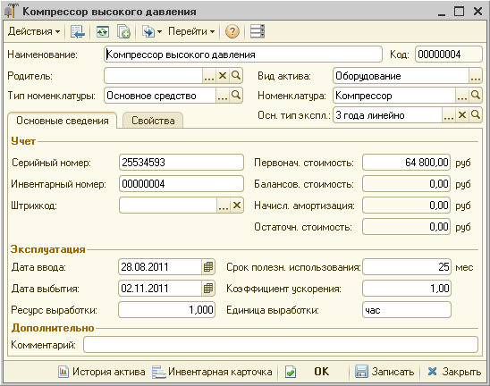
Other assets
Documents:
  Putting into service
  Movement of assets
  Assets write-off
  Disposal of assets
  Asset servicing
  Depreciation
Reports:
  Balances and turnovers of
  assets
  History of assets

Slide 66
Managing and service
User setup and rights
Scheduled tasks
Full-text search
Data exchange with accounting
Document templates
Data upload from a spreadsheet document ()
Printing price tags and labels
External processing and reports
Batch printing

Slide 67
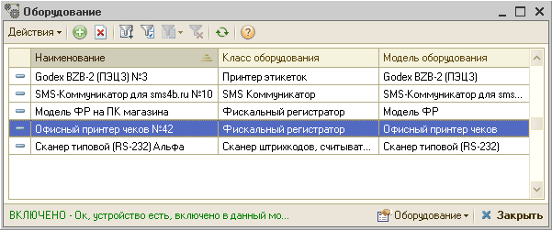
Shop equipment
Connectivity to shop equipment:
  Fiscal recorders
  Cash register
  Data acquisition terminal
  Magnetic Card Reader
  Barcode scanners
  Label Printers
  Customer display panel
  GSM-gateway

Slide 68
Activity analysis of business organization
Financial analysis
Customers debts
Financial resources on current accounts or in cash desks
Management analysis
Income and expenses
Analysis of sales and profits from sales
Warehouse analysis
Warehouse turnovers
Analysis of slow mover
Marketing analysis
Analysis of price adjestments
Active discounts and the amount of savings on discount cards of customers
Possible data presentation in any views (activity types, comparative study of budget and actual data in detail or in summary)

Slide 69
Tools for customer capture
Analysis of lost customers of workshop
Run various special offers, including seasonal offers
Providing discount cards and different discount percentage
Improvement of quality and speed of customer service through user-friendly interface
Integration "Alfa Auto" to "1C-Bitrix" for processing online orders for spare parts on the company's website
Prompt notification (SMS, email, calls) about executed automobile repair or parts delivery
ABC-customers analysis

Slide 70
Commercial information protection
Protection of personal data of employees and customers
Employee control in information base
Limits on user’s rights
Different interfaces depending on user’s work
Remote access to information base
Storing user actions history

Slide 71
Integration with other applications
“Alpha-Auto” provides integration with work and time allowance catalogues:
Silver-Dat II (file format .szf)
Audatex (file format .90)
Автонормы (file format .xml)
AutoSoft (file format .xml)
Autodata (file format .xml)
Autodata online (file format .xml)
ETKA
ELSA
With spare parts catalogues:
АвтоДилер: Каталог (file format.txt)
Microcat (file format.txt)
AutoSoft (file format.txt)
With color matching programs:
Du Pont (file format.xml)
Glasurit (file format.xml)

Slide 72
Technical support and updates
Within 3 months after registration – for free
Cost of annual support
  User support. Level “Standard” – 7 500 rub
  User support. Level “Prof” – 12 500 rub
  User support. Level “Corp” – 34 600 rub
User support:
  Consultations by phone on work days from 10:00 to 18:00 Moscow time
  Email support: alfa@rarus.ru
  Support with the use of remote access
  Providing updates (registration required http://update.rarus.ru)

Slide 73
Price list
Basic supply:
Product | Price, rub
Alfa-Auto:Car-showroom+Workshop+Auto-spare parts PROF, edition 5, for one user(software security) | 62 000
Alpha-Auto:Car-showroom+Workshop+Auto-spare parts PROF, edition 5, for one user(hardware-based security) | 64 000
Alpha-Auto:Workshop+Auto-spare parts PROF, edition 5, package for 5 users (software security) | 44 000
Alpha-Auto:Workshop+Auto-spare parts PROF, edition 5, package for 5 users (hardware-based security) | 46 000
Prices do not include cost of 1C: Enterprise 8

Slide 74
Price list
Licenses for additional workplaces:
Licenses | Price, rub
Additional license for 1 user | 5 000
Additional license for 5 user | 19 800
Additional license for 10 user | 38 000
Additional license for 25 user | 88 000
Additional license for 50 user | 165 000

Slide 75
Price list
Licenses for additional modules of Alfa-Auto:
Additions | Price, rub
Addition “Alfa-Auto”: Work time logging, edition 5 | 42 000
Addition “Alfa-Auto”: Customer Relationship Management, edition 5 | 26 000
Addition “Alfa-Auto”: Interface with Audatex, edition 5 | 24 000
Addition “Alfa-Auto”: Technical checkup, edition 5 | 14 000
Prices do not include cost of 1C: Enterprise 8

Slide 76
Licensing
“Alfa-Auto, edition 5” is not a stand-alone program, it is intended for use with platform “1C:Enterprise 8.2”
Configuration contains of protected parts of code and uses hardware or software security
“Alfa-Auto:Car-showroom+Workshop+Auto-spare parts PROF, edition 5” includes a license for one workplace
“Alfa-Auto:Workshop+Auto-spare parts PROF, edition 5 package for 5 users” includes a license for 5 workplaces
For increasing number of workplaces additional licenses for configuration “Alfa-Auto, edition 5” and client licenses for “1C:Enterprise” are needed
To work in client-server mode, user must have a license for server

Slide 77
Contact us
Address: Dmitrovskoe sh. 9B, Moscow
Phone/fax: +7 (495) 223-04-04,
+7 (495) 231-20-02
E-mail: alfa@rarus.ru
Web: www.rarus.ru

